Slide 1



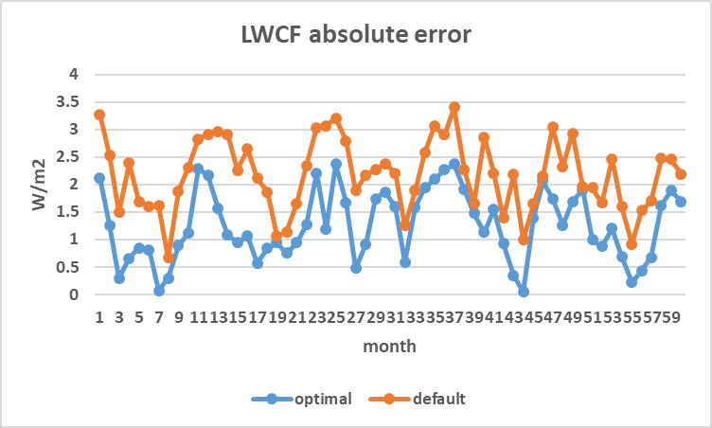
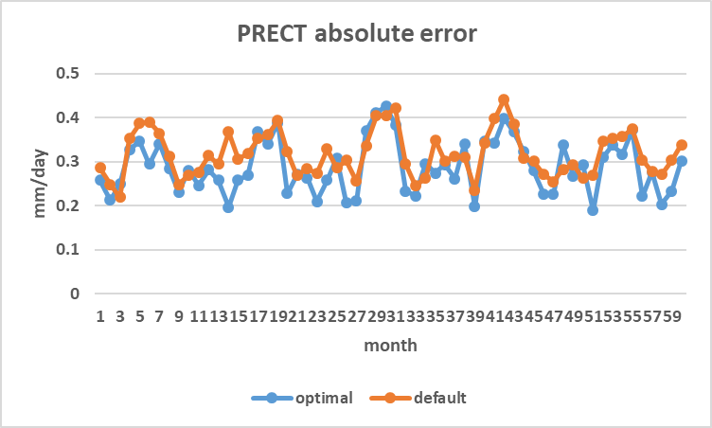
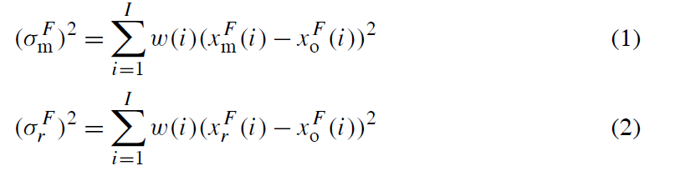
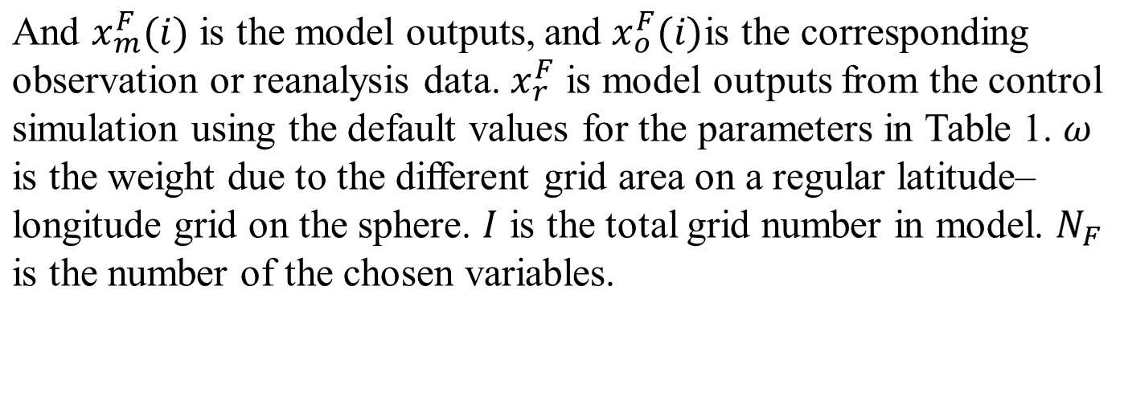
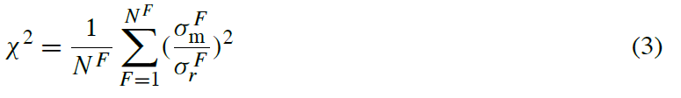

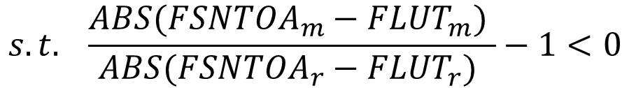
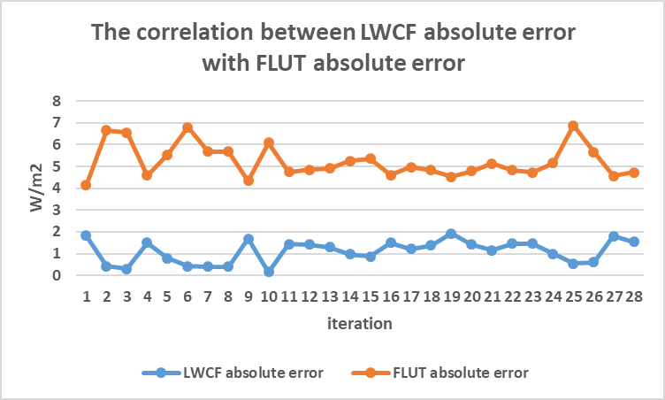
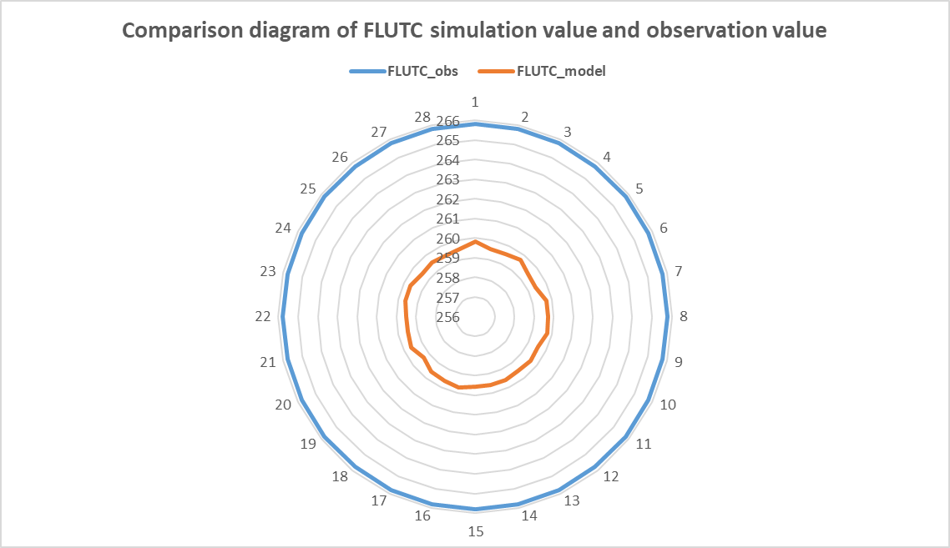

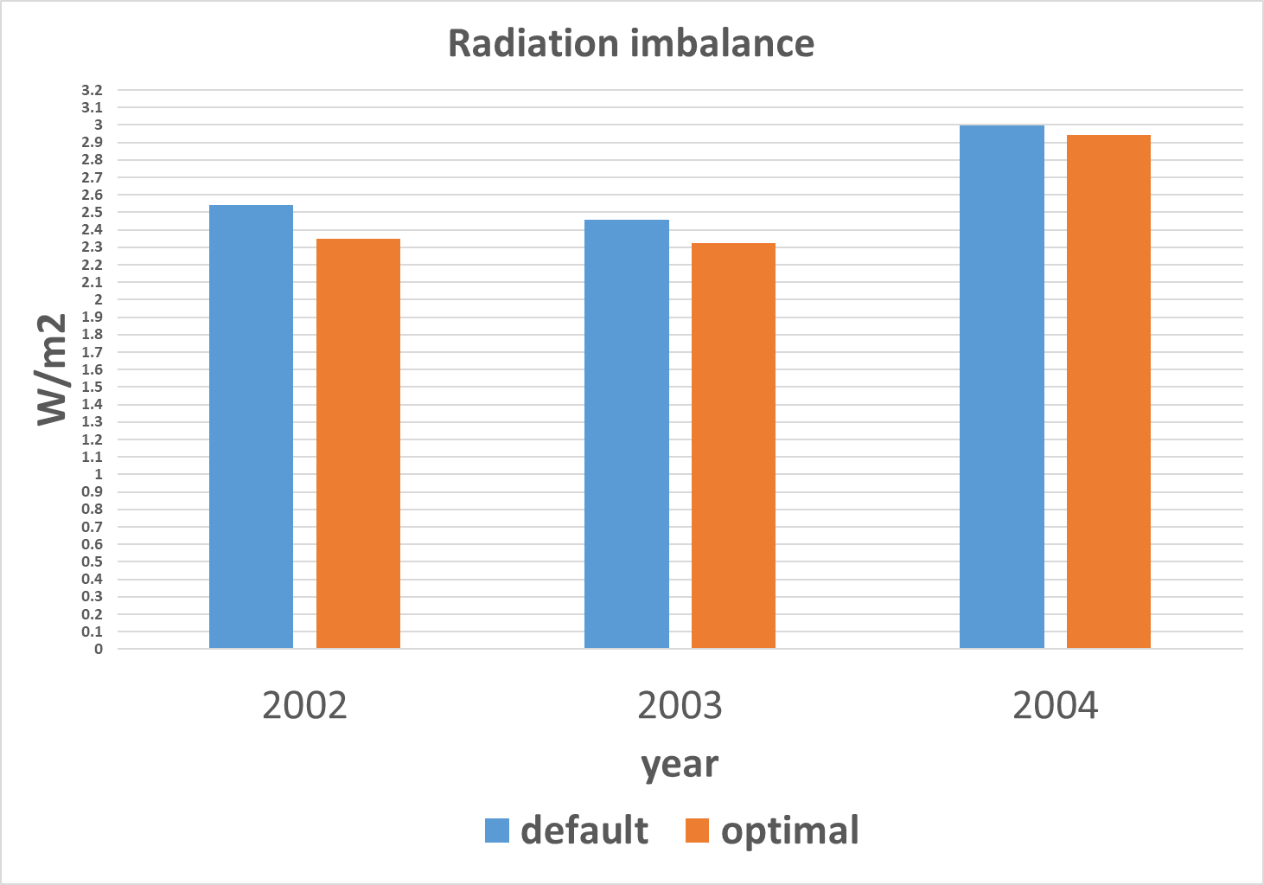
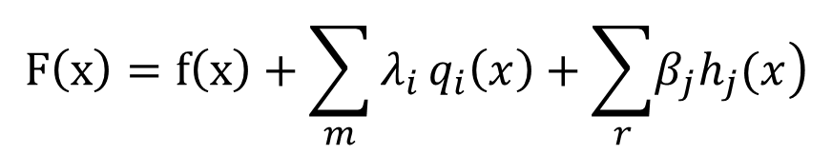
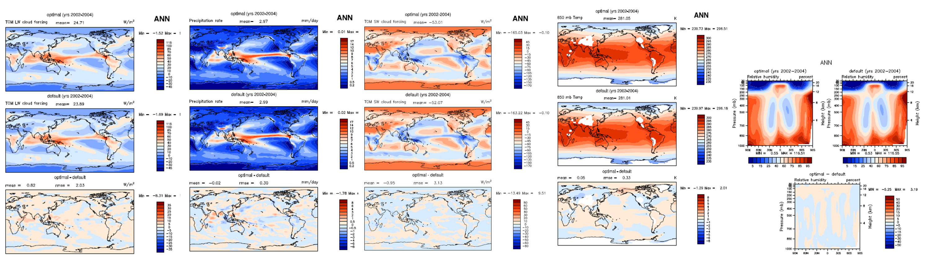
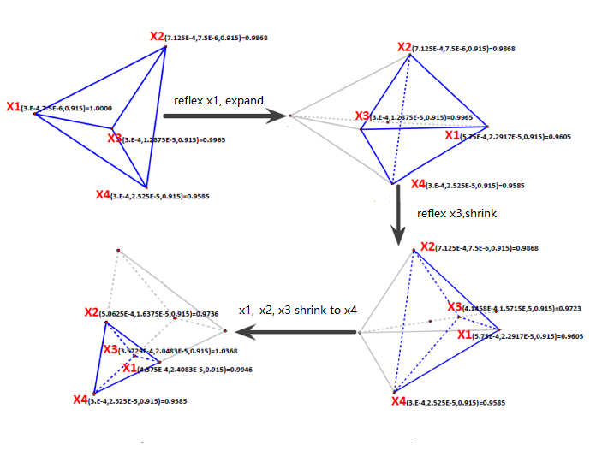
An effective parameter optimization with radiation balance constraint in CAM5
Li Wu¹，Tao Zhang^{2,3}, Yi Qin², Yanluan Lin², Wei Xue^{1,2}, Minghua Zhang⁴
1.Department of Computer Science and Technology, Tsinghua University, Beijing,China 2.Department for Earth System Science, Tsinghua University, Beijing, China
3.Brookhaven National Laboratory, New York, USA 4.School of Marine and Atmospheric Sciences, Stony Brook University, New York, USA
1. Abstract
4. Study Case
As we can see, in the optimized results, the Q850, T850 and SWCF are all near the default values, and the performance of LWCF and PRECT is improved relative to the default experiment. And the reason for the optimization results is our next work.
Uncertain parameters in physical parameterizations of General Circulation Models (GCMs) greatly impact model performance. Traditional parameter tuning methods are mostly unconstrained optimization, leading to the simulation results with optimal parameters may not meet the conditions that models have to keep.
In this study, the radiation balance constraint is taken as an example, which is involved in the automatic parameter optimization procedure. A new method , which combines the external penalty function method and the simplex downhill algorithm , is used to solve this optimization problem with constrains. In our experiment, we use CAM5 atmosphere model under 5-yr AMIP simulation with prescribed seasonal climatology of SST and sea ice. We consider the synthesized metrics using global means of radiation, precipitation, relative humidity, and temperature as the goal of optimization, and simultaneously consider the conditions that FLUT and FSNTOA should satisfy as constraints. Experiment results show that the synthesized metrics is 5.03% better than the control run. At the same time , the phenomenon of radiation imbalance has been improved with respect to the result of the default experiment. In addition, through iterative tuning, we find that A see-saw effect between LWCF and FLUT, which means that if the LWCF simulation results improve, the FLUT simulation value will be worse, and vice versa. Finally, we find that if we want to reach the target that FLUT and FSNTOA are all close to the observed values in CAM5, we must first improve the accuracy of the simulation of the FLUTC variable
We find that there was also radiation imbalance in the 5-year AMIP default experiment* in CAM5 with 2 degrees. Our experiment began in 2000 and ended in 2004. After taking the average of the longwave radiation and the shortwave radiation for the last three years, we found that the radiation error was about 2.67W/m2.
After converting constrained problems into unconstrained problems, we do simplex downhill method for the augment function. Each iterative is a 5-year AMIP experiment with a resolution of 2 degrees from 2000 to 2004, and the output of the climate average in last three years is used to calculate synthesized metrics and constraint.
For the constraints, we find that the average radiation bias over the last three years is 4.7% better than the default experiment.
Fig 5. The absolute error of LWCF and PRECT
In order to verify that we can optimize the model with the algorithms mentioned above for constrained problems, we started the following experiment.
6. Discussion
Although the problem of radiation balance has been improved, both FLUT and FSNTOA have a certain distance from the observed values. In the tuning process, it is obvious that there is a see-saw effect between LWCF and FLUT. which means that if the LWCF simulation results improve, the FLUT simulation value will be worse, and vice versa. This result also shows that the simulation results of LWCF and FLUT can not be better at the same time.
According to the formula LWCF = FLUTC-FLUT，we know that there is such a relationship between LWCF and FLUT. In order to understand why the seesaw effect exists, we also compare the simulated with observed values of FLUTC.
After calculation, we find that FLUTC simulation value always about 5W/m2 less than the observed value.
Coupled with the radiation balance constraints, the constrained optimization problem of this study can be expressed as above formula,
2. Problem
The automatic parameter optimization method can improve the overall performance of the climate model^{[1].} However, the overall performance of the model is taken as the only target without considering some necessary limitations of the mode in current method, which leads to the parameters that the optimization algorithm get cannot meet the requirements that the models should be.
Table 1. Parameters to be adjusted
Table 2. Output variables
Parameter | Range | Default
zmconv_c0_lnd | 2.95e-3 ~ 8.85e-3 | 5.9e-3
zmconv_c0_ocn | 0.0225 ~ 0.0675 | 0.045
zmconv_tau | 1800 ~ 5400 | 3600
cldfrc_rhminh | 0.6 ~ 0.9 | 0.8
cldfrc_rhminl | 0.8 ~ 0.95 | 0.8975
cldsed_ai | 300 ~ 1100 | 700
Output | Variable | Full Name | OBS
metrics variables | LWCF | Longwave cloud forcing | CERES-EBAF
 | SWCF | Shortwave cloud forcing | CERES-EBAF
 | PRECT | Total precipitation rate | GPCP
 | Q850 | Specific Humidity at 850hPa | MERRA
 | T850 | Temperature at 850hPa | MERRA
constraints variables | FLUT | Upwelling longwave flux at top of model | CERES-EBAF
 | FSNTOA | Net solar flux at top of atmosphere | CERES-EBAF
For example, in improving the overall performance of the model, we also hope that the model will ensure the radiation balance at the top of atmosphere^{[2]}, which is an important indicator of the quality of the model simulation.
So how to find a automated and efficient parameter optimization algorithm for climate models to solve the constrained problem is very critical.
3. A new method
Fig 6. The seesaw effect of LWCF and FLUT
Fig 7. The gap between the simulation value and the observed value of FLUTC
In order to meet the requirements and optimize the overall performance of the climate model, we propose a constrained optimization algorithm.
* Default parameter values are from the model configuration for CMIP5 experiments, which are recommend by climate experts.
In addition, we change the constraint condition to minimize the difference between the simulated and observed values of FLUT and FSNTOA. After 50 iterations of the optimization method mentioned in this study, We find that the seesaw effect between LWCF and FLUT still exists.
Assuming the metric to be adjusted is f (x), the inequality constraint is q (x), and the equality constraint is h (x),then the constrained optimization problem can be represented by the following formula
5. Results
This phenomenon also explains why we have been able to improve the issue of radiation imbalances in the optimization experiments, but we still can not completely solve it.
After 28 rounds of iteration optimization, we find that a set of parameters can make the synthesized metrics value optimized by 5.03%, and the gap between FL and FS is smaller than the default experiment.
7. Conclusions
Table 3. The smallest metrices in feasible solution
First of all, we take the penalty method of extrapolation to transform the constrained problem into unconstrained problem.
 | DEF | OPT
synthesized metrics | 1 | 0.949679
ABS(FLUT-FSNTOA) | 2.6647 | 2.5377
The constrained optimization algorithms for climate models mentioned in this study can help the optimizer to find better synthesized metrics under the premise of satisfying the constraints.
The see-saw effect exists between LWCF and FLUT in the optimization experiment with the radiation balance constraint, which is a hindrance to reach the target that FLUT and FSNTOA are all close to the observed values in CAM5. In order to completely solve this problem, we still need to improve the simulation accuracy of FLUTC.
Then we use the simplex downhill algorithm to iteratively optimize the augmented function F (x).
Fig 3. Radiation bias in optimization
and default simulation
The first step
extremum
The second step
8. References
Feasible region
High penalty
Trenberth, K.E., J.T. Fasullo, and J. Kiehl, 2009: Earth's Global Energy Budget. Bull. Amer. Meteor. Soc., 90, 311–323
Zhang, T., Li, L., Lin, Y., Xue, W., Xie, F., Xu, H., and Huang, X.: An automatic and effective parameter optimization method for model tuning, Geosci. Model Dev., 8, 3579-3591
Low penalty
Infeasible region
Solving path
Fig 1. External penalty function method diagramre
Fig 2. Simplex downhill
algorithm diagram
Fig 4. Comparison between the optimized experiment and the default experimentg
Email:wuli_qhu@163.com / xuewei717@gmail.com

